Slide 1
Cornerstone City Church Peninsula Plus Community Hoo Are Ya
28th September 2025

Slide 2


Slide 3
I Thank God
CCLI Song # 7169680
Aaron Moses | Chuck Butler | Dante Bowe | Enrique Holmes | Jesse Cline | Maryanne J. George
© 2021 Aaron Moses Chiriboga Music; Be Essential Songs; Holmeboy Music Group; Jesse Cline Publishing Designee; Jord A Lil Music; Bethel Worship Publishing; Heritage Worship Music Publishing; Maverick City Publishing; MJ George Music
For use solely with the SongSelect® Terms of Use. All rights reserved. www.ccli.com

Slide 4
1/8
Wandering into the night wanting a place to hide
This weary soul this bag of bones
I try with all of my might
But I just can't win the fight
I'm slowly drifting a vagabond

Slide 5
2/8
And just when I ran out of the road
I met a man I didn't know
And He told me that I was not alone

Slide 6
3/8
You picked me up You turned me around
And placed my feet on solid ground
I thank the Master I thank the Savior
Because You healed my heart You changed my name
Forever free I'm not the same
I thank the Master I thank the Savior I thank God

Slide 7
4/8
I cannot deny what I've seen
Got no choice but to believe
My doubts are burnin' like ashes in the wind
So, so long to my old friends
Burden and bitterness
You can just keep them moving
Nah you ain't welcome here

Slide 8
5/8
From now till I walk streets of gold
I'll sing of how You saved my soul
This wayward son has found his way back home

Slide 9
6/8
You picked me up You turned me around
And placed my feet on solid ground
I thank the Master I thank the Savior
Because You healed my heart You changed my name
Forever free I'm not the same
I thank the Master I thank the Savior I thank God

Slide 10
7/8
Hell lost another one
I am free I am free I am free
(REPEAT)
Hell lost another one
I am free I am free

Slide 11
8/8
You picked me up You turned me around
And placed my feet on solid ground
I thank the Master I thank the Savior
Because You healed my heart You changed my name
Forever free I'm not the same
I thank the Master I thank the Savior I thank God

Slide 12
Turn It Up
CCLI Song # 6621485
Andy Harrison
© 2012 Planetshakers Ministries Int. Inc. (Admin. by Song Solutions www.songsolutions.org)
For use solely with the SongSelect® Terms of Use. All rights reserved. www.ccli.com
CCLI Licence No. 33265

Slide 13
1/6
You are here as we lift You up
You are riding on our praise
Be enthroned over everything
You are seated in our praise

Slide 14
2/6
This is prophetic I can feel it in the air
We lift our praise and You change the atmosphere
With hearts open now everybody singing out
(Oh)
(I am free)

Slide 15
3/6
Turn it up this sound of praise
Make it louder than any other
Lift Him up and shout His name over all

Slide 16
4/6
As we praise I can feel the change
As Your presence now invades
Hear the sound of the broken chains
Prison doors are giving way

Slide 17
5/6
Our praise goes up
Your rain comes down
(REPEAT)

Slide 18
6/6
With shouts of praise we celebrate
King of glory enter in
You are riding on our praise oh Lord

Slide 20
Thanksgiving
CCLI Song # 7199589
Nick Herbert | Taku Mudere | Zo Chilengwe
© Capitol CMG Genesis; Safe and Sound Music; Remaining portion is unaffiliated
For use solely with the SongSelect® Terms of Use. All rights reserved. www.ccli.com
CCLI Licence No. 33265

Slide 21
1/10
Enter in (Enter in)
His courts with praise (His courts with praise)
For He is greatly (He is greatly)
To be praised (To be praised)

Slide 22
2/10
Enter in (Enter in)
His courts with praise (His courts with praise)
For He is greatly (He is greatly)
To be praised

Slide 23
3/10
What shall we do
We shall lift up a shout
What shall we do
We shall praise Him
What shall we do
For our God made a way
We'll give Him our thanksgiving

Slide 24
4/10
Magnify (Magnify)
His Holy Name (His Holy Name)
For He is greatly (For He is greatly)
To be praised (To be praised)

Slide 25
5/10
Magnify (Magnify)
His Holy Name (His Holy Name)
For He is greatly (For He is greatly)
To be praised

Slide 26
6/10
What shall we do
We shall lift up a shout
What shall we do
We shall praise Him
What shall we do
For our God made a way
We'll give Him our thanksgiving

Slide 27
7/10
Even if the rocks cry out
We're gonna drown them out
With a louder shout of praise
Even when the battles roar
We're gonna praise You Lord
'Cause You are always worthy

Slide 28
8/10
You are worthy
Worthy of honour and praise
You are worthy
We'll sing it again and again

Slide 29
9/10
What shall we do
We shall lift up a shout
What shall we do
We shall praise Him
What shall we do
For our God made a way
We'll give Him our thanksgiving

Slide 30
10/10
We'll give Him our thanksgiving
We'll give Him our thanksgiving

Slide 32
Goodness Of God
CCLI Song # 7117726
Ben Fielding | Brian Johnson | Ed Cash | Jason Ingram | Jenn Johnson
© 2018 Capitol CMG Paragon (Admin. by Capitol CMG Publishing)
Fellow Ships Music (Admin. by Essential Music Publishing LLC)
So Essential Tunes (Admin. by Essential Music Publishing LLC)
SHOUT! Music Publishing Australia (Admin. by SHOUT! Music Publishing UK)
Bethel Music Publishing (Admin. by Song Solutions)
For use solely with the SongSelect® Terms of Use. All rights reserved. www.ccli.com
CCLI Licence No. 33265

Slide 33
1/6
I love You Lord
Oh Your mercy never fails me
All my days
I've been held in Your hands
From the moment that I wake up
Until I lay my head
I will sing of the goodness of God

Slide 34
2/6
All my life You have been faithful
All my life You have been so so good
With every breath that I am able
I will sing of the goodness of God

Slide 35
3/6
I love Your voice
You have led me through the fire
In darkest night
You are close like no other
I've known You as a father
I've known You as a friend
I have lived in the goodness of God

Slide 36
4/6
All my life You have been faithful
All my life You have been so so good
With every breath that I am able
I will sing of the goodness of God

Slide 37
5/6
Your goodness is running after
It’s running after me
(REPEAT)
With my life laid down
I’m surrendered now
I give You everything
Your goodness is running after
It's running after me

Slide 38
6/6
All my life You have been faithful
All my life You have been so so good
With every breath that I am able
I will sing of the goodness of God

Slide 39
Build My Life
CCLI Song # 7070345
Brett Younker | Karl Martin | Kirby Kaple | Matt Redman | Pat Barrett
© 2016 Capitol CMG Genesis (Admin. by Capitol CMG Publishing)
Housefires Sounds (Admin. by Capitol CMG Publishing)
sixsteps Music (Admin. by Capitol CMG Publishing)
Vamos Publishing (Admin. by Capitol CMG Publishing)
worshiptogether.com songs (Admin. by Capitol CMG Publishing)
Said And Done Music (Admin. by Integrity Music Ltd)
Thankyou Music (Admin. by Integrity Music Ltd)
Martin, Karl Andrew (Admin. by Sentric Music)
Bethel Music Publishing (Admin. by Song Solutions)
Kaple Music (Admin. by Song Solutions)
For use solely with the SongSelect® Terms of Use. All rights reserved. www.ccli.com
CCLI Licence No. 33265

Slide 40
1/4
Worthy of ev'ry song we could ever sing
Worthy of all the praise we could ever bring
Worthy of ev'ry breath we could ever breathe
We live for You

Slide 41
2/4
Jesus the name above ev'ry other name
Jesus the only one who could ever save
Worthy of ev'ry breath we could ever breathe
We live for You
We live for You

Slide 42
3/4
Holy there is no one like You
There is none beside You
Open up my eyes in wonder and show me who You are
And fill me with Your heart
And lead me in Your love to those around me

Slide 43
4/4
I will build my life upon Your love
It is a firm foundation
I will put my trust in You alone
And I will not be shaken

Slide 44


Slide 45
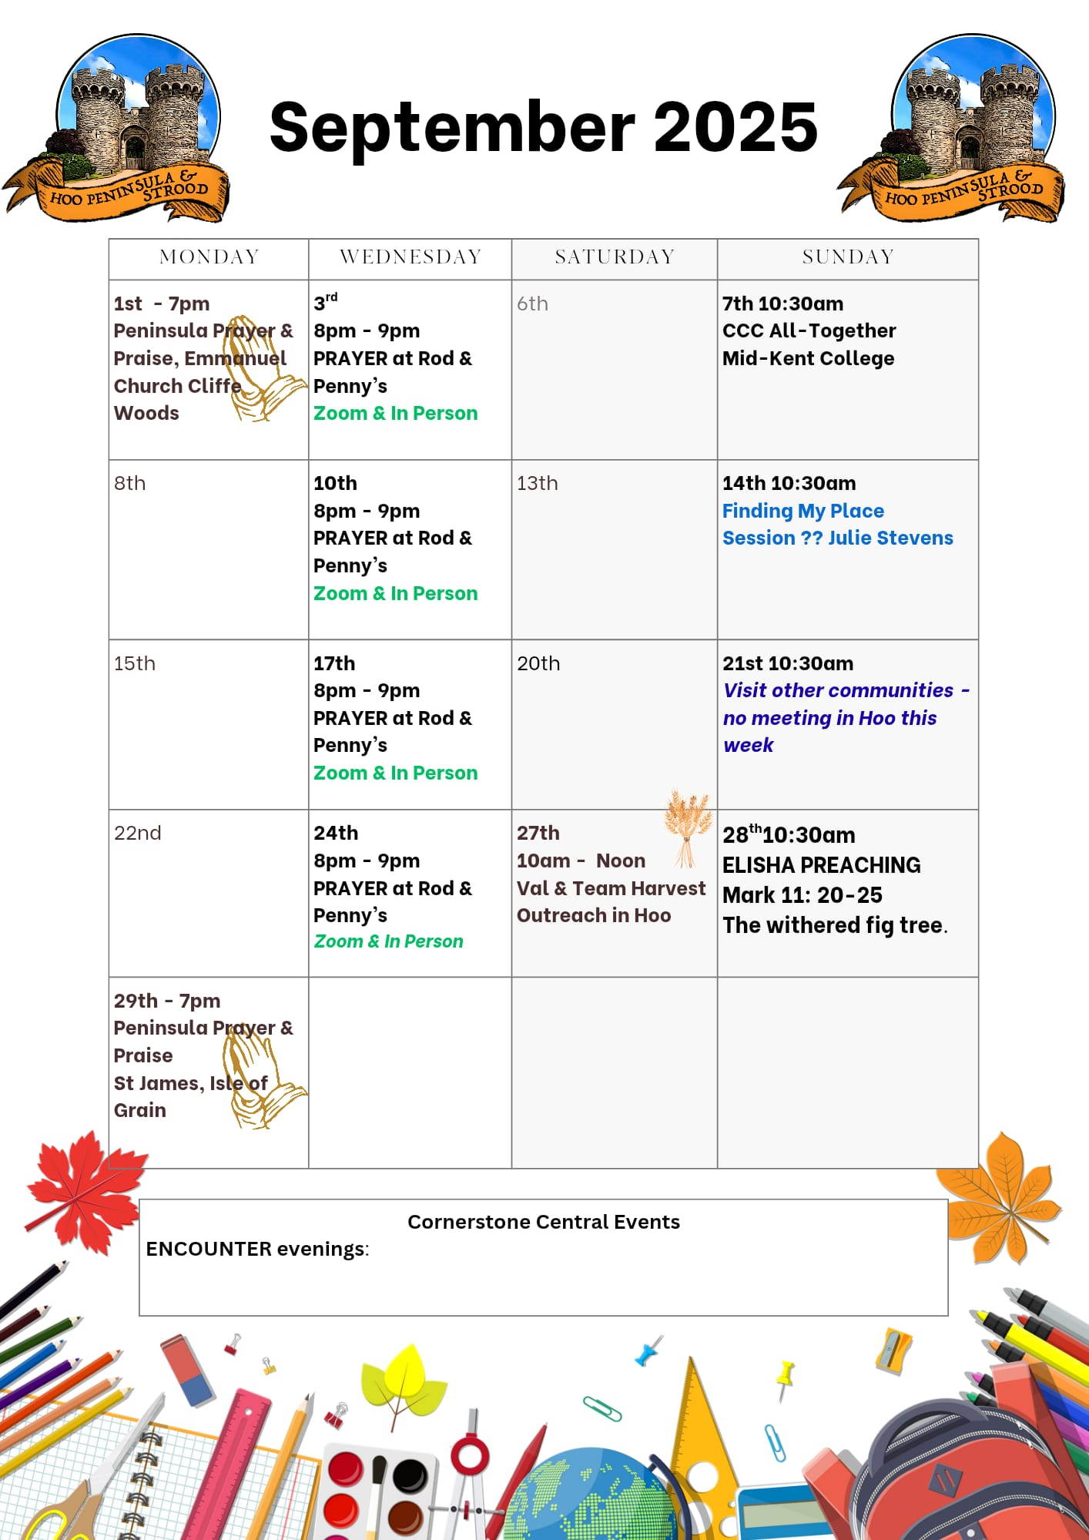

Slide 46

Grow Group 1
On YOUR MARK!

Slide 47
Leaders
Leaderss
Phil & Kim
Maria (Mia) Warren
Matthew Harrison
Richard & Elisha Acheampong
Phil & Kim
Maria (Mia) Warren
Matthew Harrison
Richard & Elisa Acheampong

Slide 48

Storm Walker
Storm Walker
Symbolising, trust in Jesus Christ through life's storms.
Mark 4:35-41

Slide 49


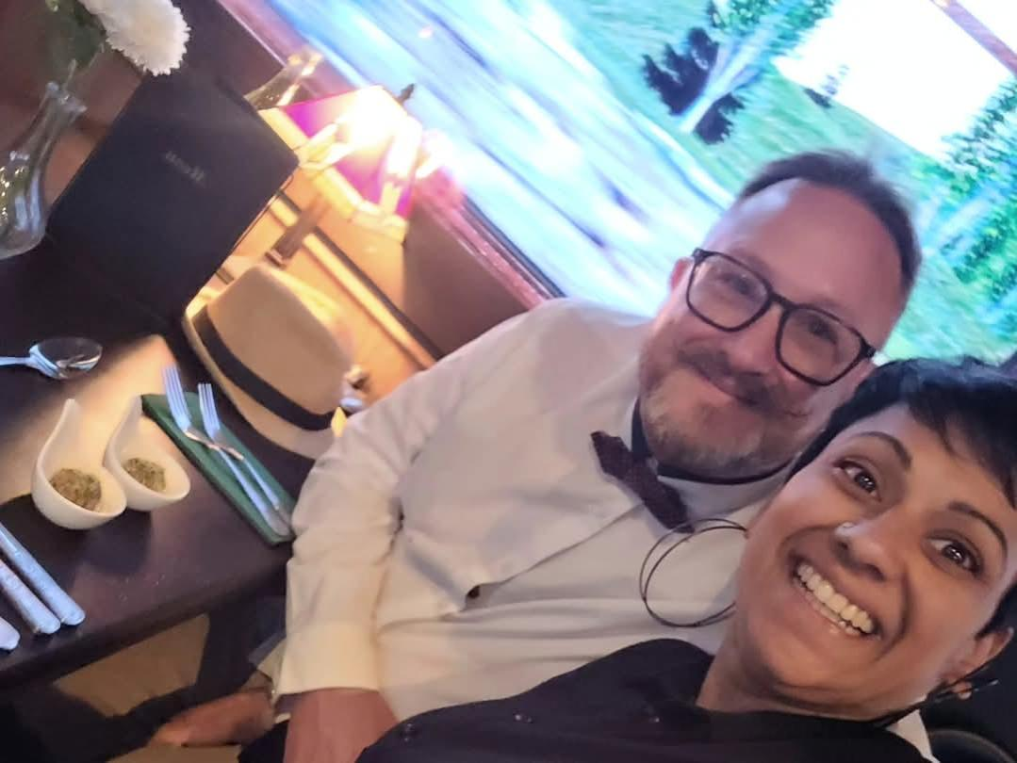
Group Leaders
Micheal and Mwamba
Wilfred and Parveen
Hannah

Slide 50


Slide 51


Slide 52
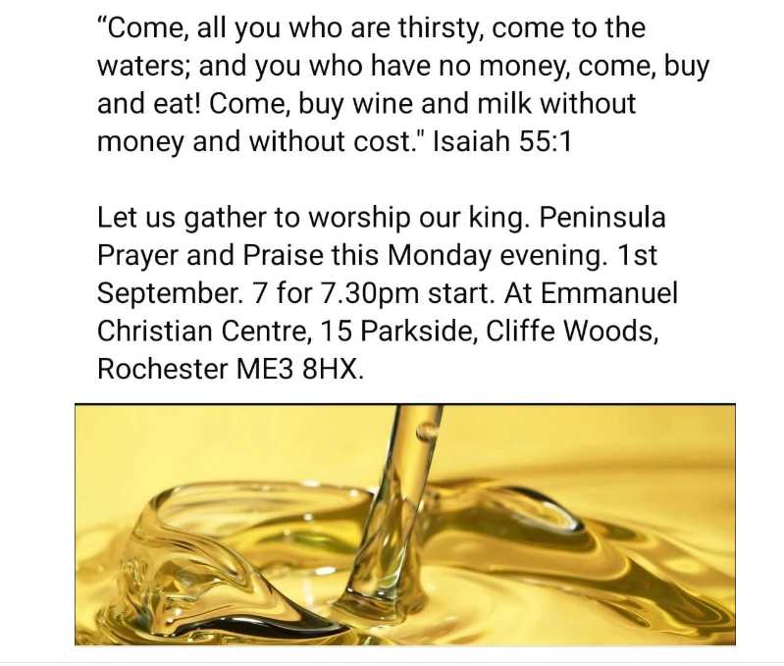

Slide 53


Slide 54
2 Corinthians 14 May the grace of the Lord Jesus Christ, and the love of God, and the fellowship of the Holy Spirit be with you all
Surely goodness and mercy shall follow us all the days of our lives, and we shall dwell in the house of the Lord forever.

